Slide 1

FACILITY PLANNING AND LAYOUT
Vital Vitamins co.
BY:
MUSTAFA KADRI
JATIN SHARMA

Slide 2
INTRODUCTION
The new VV facility has been fully equipped to operate for the ensuing five years. The operational portion of our business consists of picking, distribution, order fulfillment, manufacturing, receiving finished goods, and price ticketing.
For the next five years, we are creating a facility that successfully and efficiently combines all of the operations.
We have the projected sales for the next 5 years(including online and phone sales and store sales).
The final project determines the overall size of the building required.
Number of dock doors required.
Number of manufacturing lines required.
Storage and handling equipment and Staffing.

Slide 3
EXECUTIVE SUMMARY
To fulfill operational demand and meet the expansion projections of Vital Vitamins (VV), we suggest utilizing 173,000 square feet for the current warehouse, of which 154,419 square feet will be dedicated to warehousing and distribution operations.
We advise adding a high-speed production line to the enlarged facility to further expedite output and satisfy future demand. In addition, to maximize productivity and minimize expenses, we propose relocating the price ticketing operation to the central facility within the expanded warehouse. This strategic move would enable economies of scale and enhanced management of product pricing. This calculated action is expected to result in a 20% decrease in price ticketing costs.

Slide 4
DATA PROFILING
Company Profile Summary: - Vital Vitamins (VV) is a manufacturer and distributor of vitamin supplements and sports nutrition products. - VV has product lines that include proteins, etc. - They produce both proprietary products and generic versions sold under Vital Brand™. - Distribution occurs through VV's own retail stores and direct consumer channels such as online and phone orders.
Facility Requirements: - VV is considering two new facility sizes: 173,000 ft² or 215,000 ft². - The facility will include 25,000 ft² for corporate offices, 4,000 ft² for manufacturing of Vital Brand™, and 3,000 ft² for a retail outlet store. - The remaining area will be used for warehousing and distribution: either 141,000 ft² or 183,000 ft². - The facility will have a clear stacking height of 36 ft. - There are provisions for up to 16 dock doors, but only 12 are currently proposed due to cost and city regulations.

Slide 5
DATA PROFILING
Operational Details: VV receives two types of raw materials: bulk vitamins in boxes on pallets and empty bottles for filling with vitamins. - The finished goods are ready for resale without further processing. - Work orders in manufacturing involve filling bottles with vitamins, labeling, and ticketing. - Shipping for store restocks is done with company trucks. Parcel shipment vehicles are used for direct-to-customer orders. - VV operates from 8 am to 8 pm with a possibility of overtime for same-day shipping orders received before 3 pm. - Customer returns are outsourced and not part of this facility's design.
Shipping includes palletized totes for store replenishment and individual cartons for direct-to-customer orders. 5. Project Objectives and Growth Projections: - Design a facility that integrates material handling, storage, and product flow for VV's future needs, including manufacturing space for Vital Brand™. - Online and phone sales are projected to grow by 20% per year, and store sales by 10% per year. - The facility should accommodate peak volume levels forecasted 5 years into the future.

Slide 6
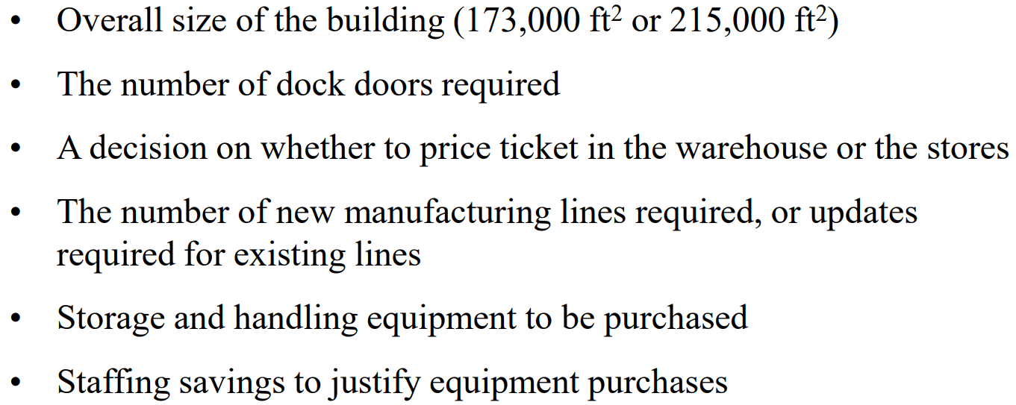
FINANCIAL IMPACT CONSIDERATION

Slide 7
PROBLEM STATEMENT
The problem is to design a new Vital Vitamins (VV) facility that effectively integrates material handling, storage, and product flow to meet the company’s future needs. The goal is to create a facility that can accommodate the projected growth rates of online and phone sales (20% per year) and store sales (10% per year) for the next five years. The design must also consider the current inventory and sales data, order characteristics, and financial impacts. Additionally, the facility should include manufacturing space for the Vital Brand™ products. The design must be submitted to upper management for budget approval, and all significant financial impacts must be clearly documented and justified.

Slide 8
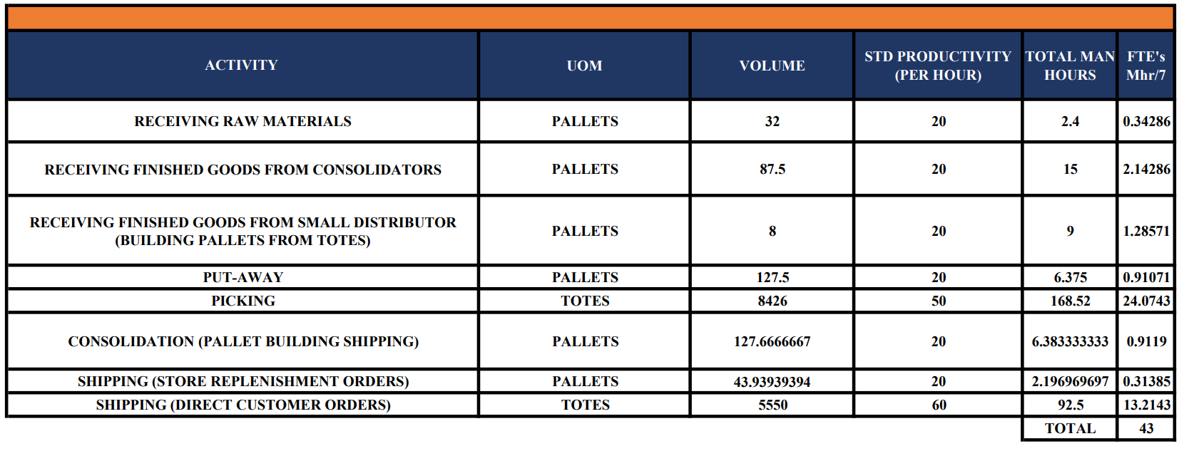
OPERATIONAL PLAN
DETAILED LABOR PLAN

Slide 9
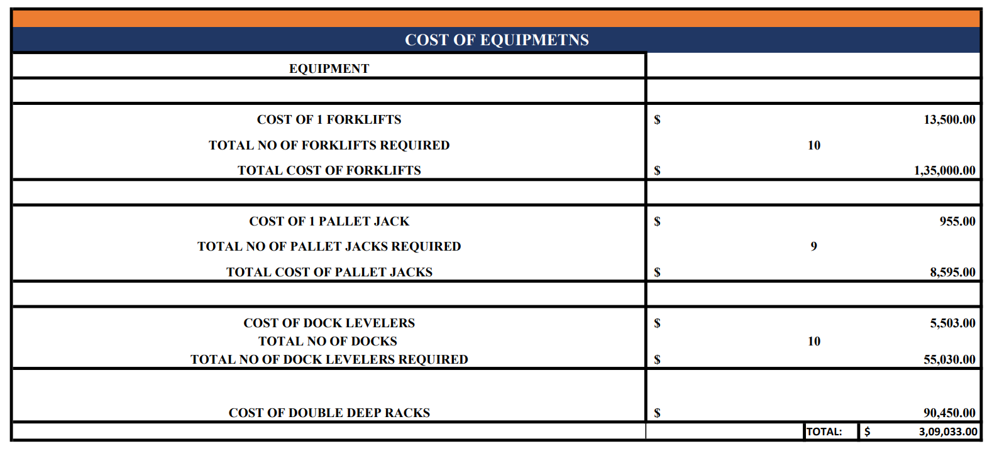
EQUIPMENT SELECTION

Slide 10
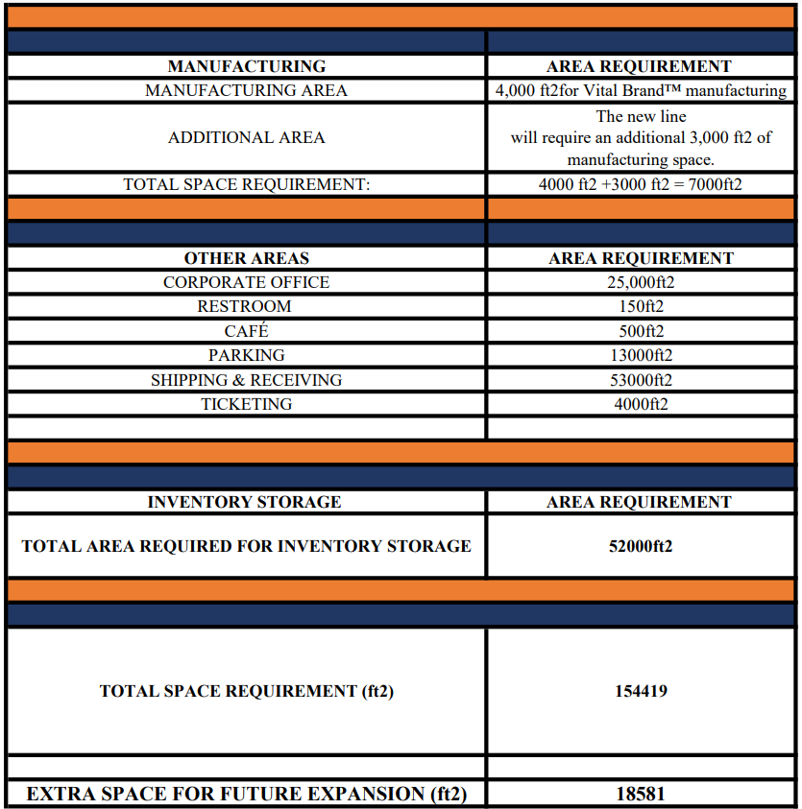
TOTAL SPACE REQUIREMENTS

Slide 11
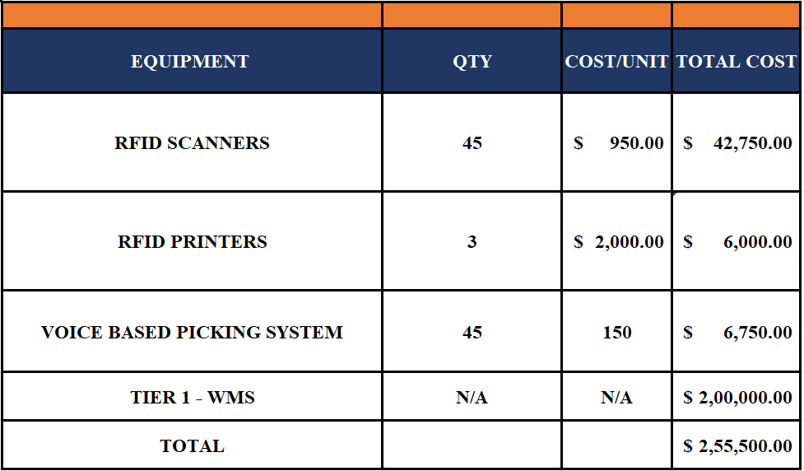
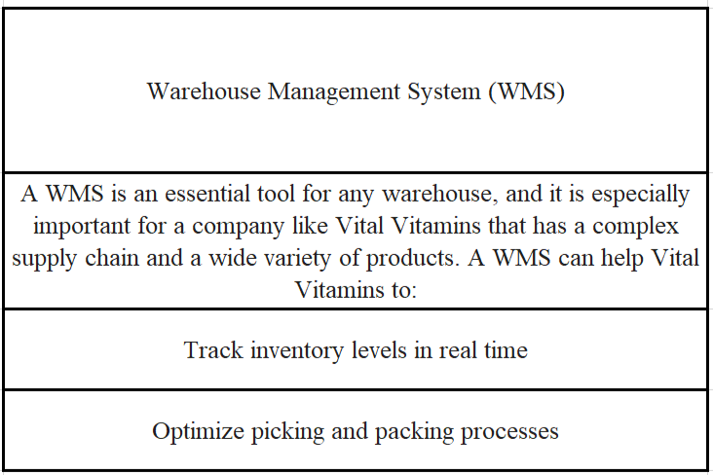
PROPOSED TECHNOLOGY SOLUTION

Slide 12
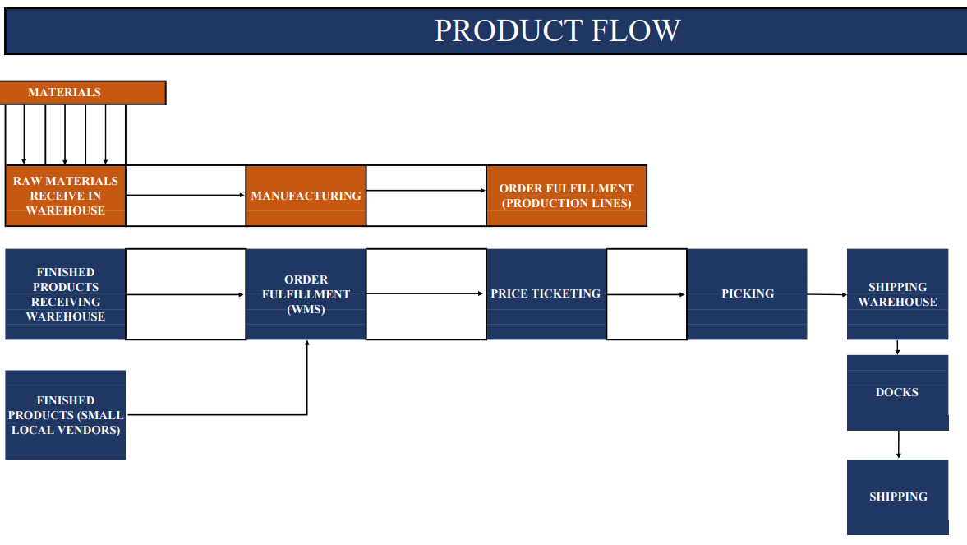
PROPOSED DESIGN AND PRODUCT FLOW

Slide 13
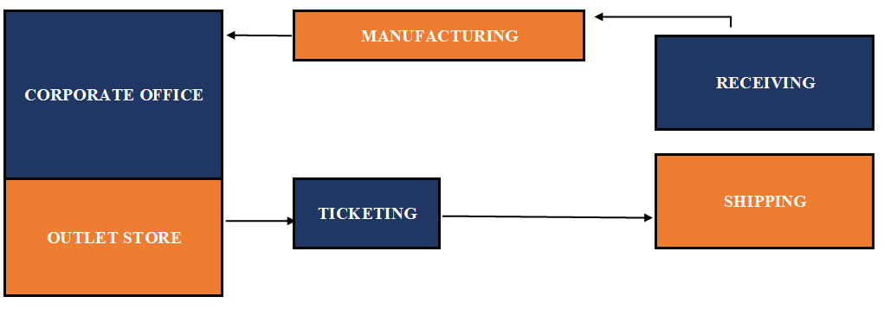
PRODUCT FLOW WITHIN PROCESS DEPT
U - FLOW

Slide 14
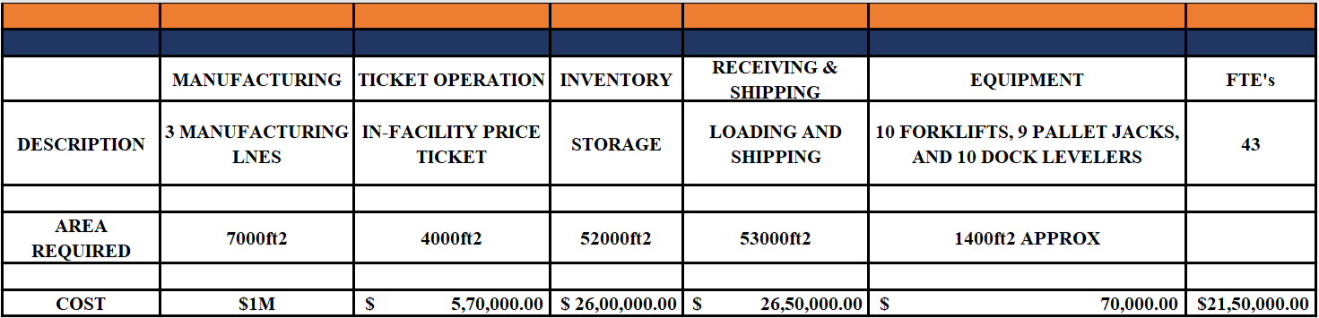
IMPLEMENTATION PLAN

Slide 15
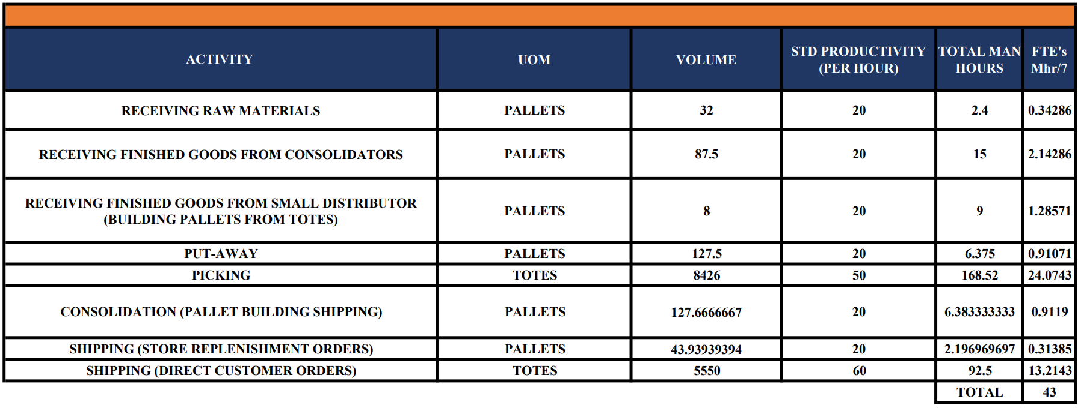
FTES

Slide 16
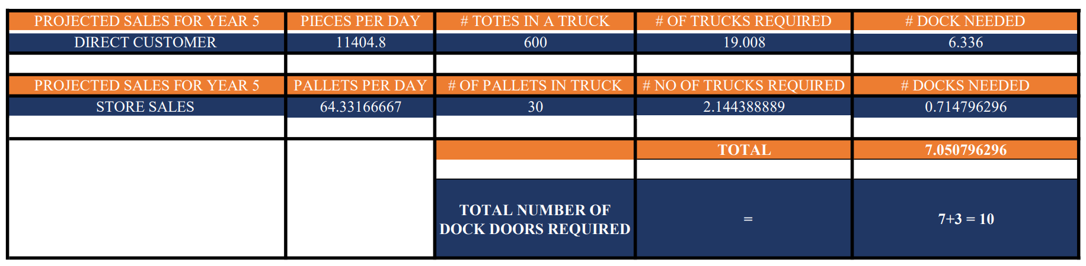
DOCK DOOR CALCULATION

Slide 17
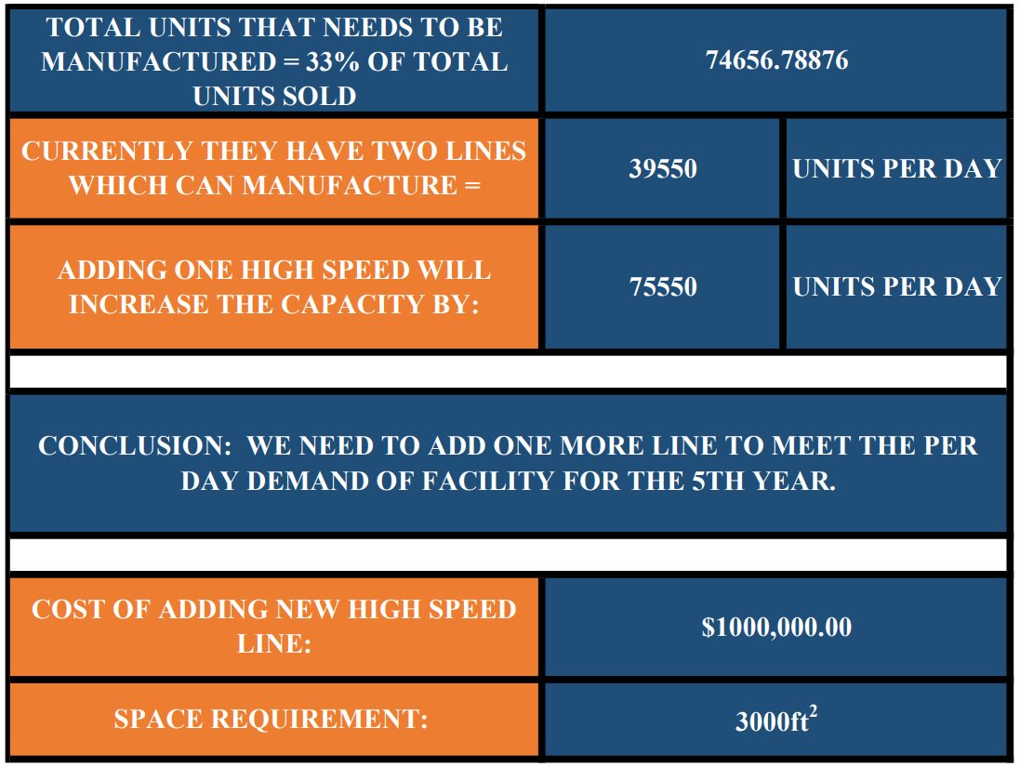
MANUFACTURING

Slide 18
OVERALL INTEGRATION
Price Ticketing: To optimize efficiency and reduce costs, we have decided to centralize price ticketing operations in the warehouse, leveraging economies of scale and streamlining the process.
Placing shipping and storage areas can significantly reduce material handling costs by minimizing the distance traveled by workers and equipment, leading to a potential reduction.
An excess of approximately 18,581 square feet of space provides the flexibility to accommodate future facility upgrades and expansions, ensuring adaptability and scalability to meet evolving business needs.
Nearby customer parking present on the west side of the facility is used for corporate office and outlet store.

Slide 19
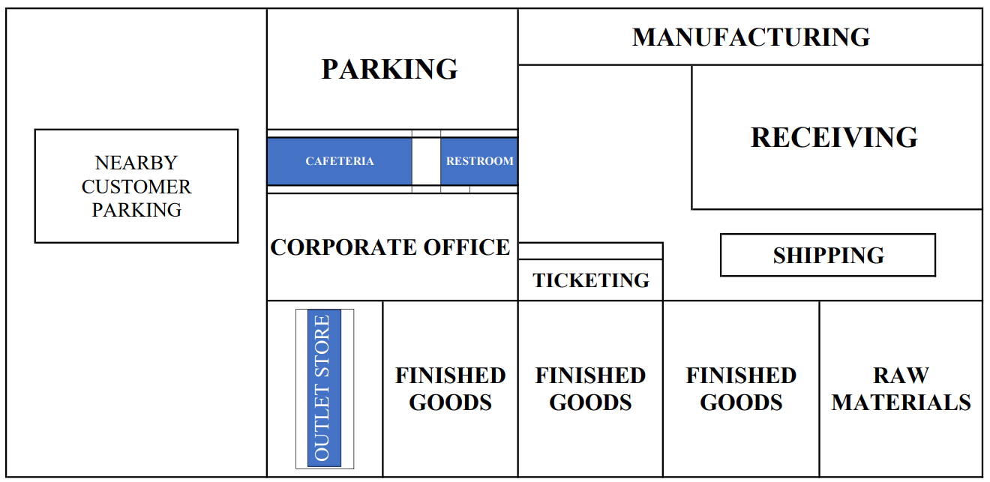
FACILITY LAYOUT

Slide 20
ECONOMIC JUSTIFICTAION
New High Speed Line: Upgrading both of the current lines would not have allowed us to satisfy consumer expectations through the end of the fifth year, therefore we plan to establish a new high-speed line, costing $1 million. Given that we need 74,657 units every day. In addition to the two current lines, a new high-speed line could be added to meet this demand.
FTEs – We need 43 FTEs and Wages of 28 employees for a year will be $21,50,000.
Total cost of equipment: The total cost of equipment is $309033. If we lower the number of equipment, we would need to hire fulltime employees, which could have an impact on the company's production as efficiency varies during the day.
Pricing Ticketing Decision: Pricing and Ticketing Decision: If we operate the ticketing business out of the building, it will cost $595000, which is less than the $1 million cost of ticketing in the store. Additionally, we are presuming that tickets are sold for products that are sold directly to customers by other manufacturers.

Slide 21
CONCLUSION
The entire area allotted for warehouse design is 173000 square feet; taking into account the facility's movement through 2023, the designed facility has 154419 square feet, plus an additional 10% for future development. Including the existing facility's office and tickets.
12 dock doors are required.
we recommend adding a new highspeed line in addition to the existing 2 lines to satisfy the demand of the facility for the next 5 years.
Price ticketing operation: In an effort to enhance operational efficiency and achieve significant cost savings, we have decided to relocate price ticketing operations to the central facility. This strategic move is economically justifiable, considering the projected reduction in labor costs, streamlined workflows, and centralized management of pricing processes. Reduced the cost by 20%.

Slide 22
THANK-YOU

